Slide 1
Wednesday Meeting Updates Sept 28th 2016
UBC Chem-E-Car | Engineering Design Team The University of British Columbia, Vancouver
www.ubcchemecar.com

Slide 2

ADMIN UpDATEs - 1
Generate 2016 conference, registration closing soon! Anyone else interested? Talk to Abhi, Said or Victor
Why join? Free conference tix worth $100+ Fancy food at the Hyatt downtown Potential $500 prize for the winner Presentation experience Networking with co-op employers (huge advantage over your peers if you’re in second year)

Slide 3
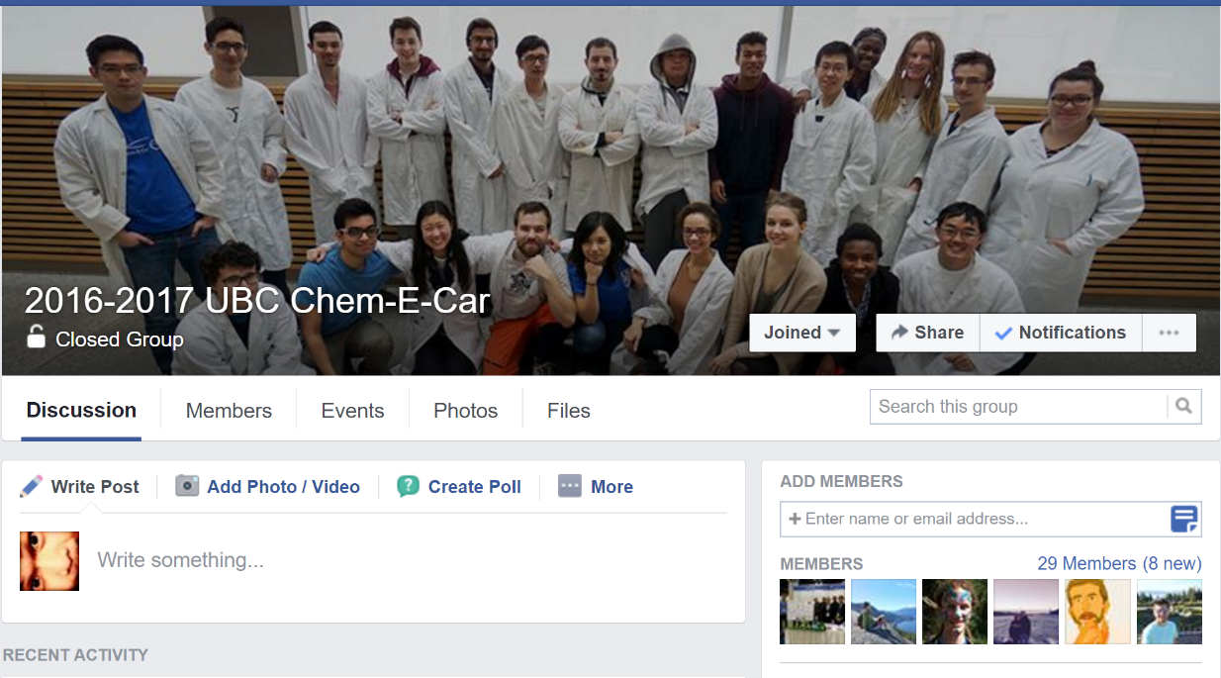
Admin updates - 2
Sign up for the mailing list www.ubcchemecar.com/joinus.html
Join the FB group, search for ‘2016-2017 UBC Chem-E-Car’
Join your sub-team’s group chats

Slide 4
Junior CAR ORGIZATION CHART - UPDATE
Associate Captains (Project Co-Leads) (Abhi, Victor)
Mechanical Lead [Breanna, Caitlin]
Electrical Lead [Abhi, Victor]
Assistant Captains (Admin Leads) [Said]
Project Admins [Many Roles!]
Workshop Managers [Vacant]
Battery Lead [Jaspreet]
Clock Lead [Josh, Jayg]
Can have max of two co-leads for each role to share the workload
Notes:
Abhi, Victor

Slide 5

CHEM-E-CAR OVERVIEW
AIChE (American Institute of Chemical Engineers)
Professional organization for chemical engineers in North America
AIChE organizes the annual Chem-E-Car competitions (regionals and nationals)
FREE membership for undergraduate students. Why register?
Access to educational videos and industry updates
Student membership required for participation in AIChE conferences and Chem-E-Car competitions
Link to register: http://www.aiche.org/community/students/student-membership

Slide 6
CHEM-E-CAR COMPETITION
OBJECTIVE Design a shoebox-sized car that will accurately travel a certain distance while carrying a specified weight of water.
This is not a race. Competition is about accuracy, not speed.

Slide 7
Constraint 1
Car must start and stop using only chemical reactions. That means no timers, video cameras, remote controllers etc.

Slide 8
Constraint 2
The car’s motor must be powered using only chemical reactions. Can be pressure-based, electrochemical-based etc.
No commercial batteries allowed for the motor, but can be used to power Arduinos, sensors or other electronics.

Slide 9
Constraint 3
Distance and weight of water: not given until an hour before the competition.

Slide 10

chemical clock
Chemical clocks control how far the car moves. Clock timing manipulated by concentration, pressure etc. EXAMPLE: Iodine clock - Two solutions, A & B (both colorless initially, black after mixed)
- Time needed to change color dependent on concentrations of A and B
- Color change measured by light sensors and cuts off circuit

Slide 11
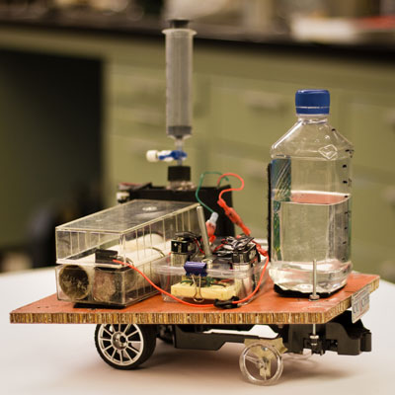
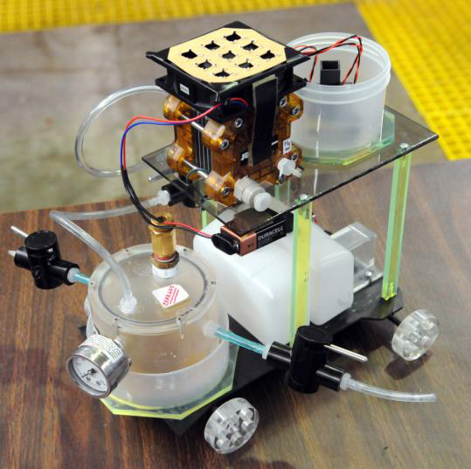
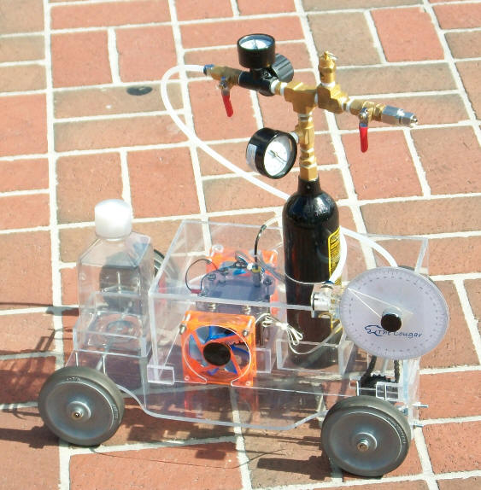
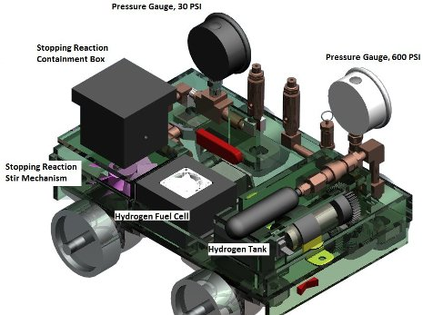
Power sources
Pressure tanks, Batteries, Fuel cells
Biological reactions AIChE is offering a special $1,000 award for “Best Use of a Biological Reaction to Power a Car”

Slide 12
Before the competition
Prepare and submit an Engineering Documentation Package (EDP) to AIChE for inspection. [TIP: APPOINT AN EDP MANAGER!] Very detailed document on all aspects of the car including chemical reactions, chemicals used, safety considerations, electronic components etc. Easily 60+ pages including electronics specs sheets, MSDS and other appendices.
Test the car and collect data. Generate calibration curves.
Distance
Concentration of Clock Chemicals

Slide 13
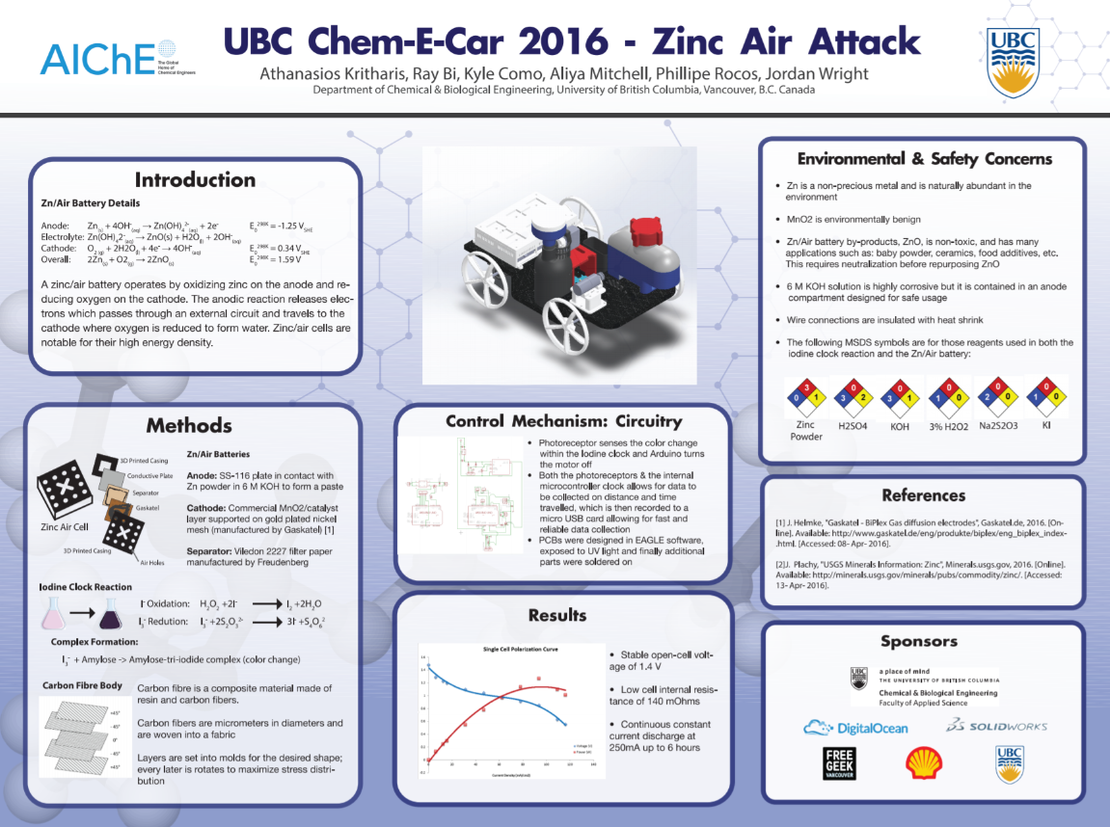
BEFORE THE COMPETITION
Make a research poster explaining how the car works and the reactions used
Poster will be presented to the judges during the competition. Award available for best poster presentation.

Slide 14
Competition day
Finish
Teams given 15 minutes to prepare batteries + clock chemicals. Important to have a battery and clock that’s easy and fast to assemble
V-shaped markings on the floor. Disqualified if car runs outside the markings. Mech team: make sure car moves in a straight line
Teams scored by measuring distance from the front of the stopped car to the finish line. Team with smallest distance wins!
Start
Car

Slide 15
APP Competition rules (from the aiche website)
APP must be useful for an AIChE member.
Possible application areas: scientific, engineering, teaching and professional meeting organizers.
For example, teaching apps could include a game designed to teach chemical engineering concepts.
Suggested features of a winning APP
APP enhances student or professional performance/quality of life.
APP is built using high quality content of ChE/Chemistry/Engineering
APP functions with few to no errors
APP should be more than just a handbook
APP may be a game to promote chemical engineering to society

Slide 16

Current idea: water quality testing app
Remote Server
Backend: Rails, node.js, Python (Django)?
Mobile Platform (App)
Arduino or Raspberry Pi
Sensor Module
Bluetooth comms
Water quality testing conductivity, pH, TDS etc
Native (pure) Android? iOS? Hybrid (web apps)?

Slide 17
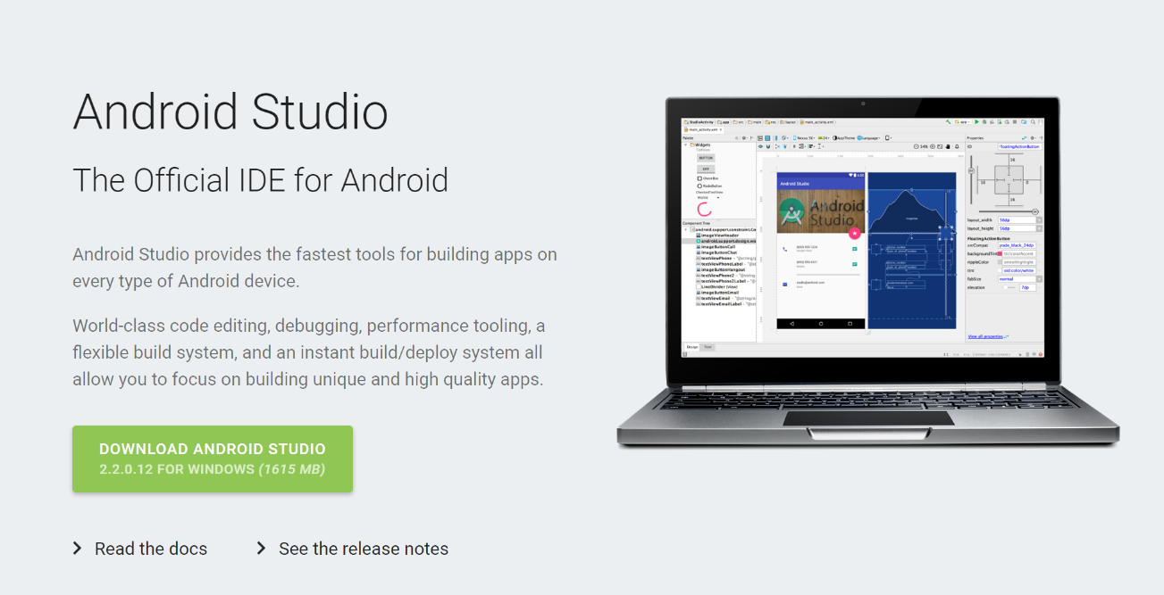
Getting started: android
Learn some basic Java
Download Android Studio from android.com
Read the tutorials on https://developer.android.com/training/index.html

Slide 18
ACTION ITEMS: BATTERY AND CHEMICAL TEAM
Battery and chemical clock proposals (the sooner the better): - Will give lab access when we receive solid and detailed proposals - Team leads work together with your members to choose the best proposals (or top 3? If you have multiple good proposals) - We will help you order chemicals when you are ready!
If you need help or feedback from the senior team, talk to Andy, Mani, Arjun, Negar or Ray

Slide 19
ACTION ITEMS: JUNIOR MEETINGS
Senior team will be busy with Nationals car for the next few weeks.
But we will be around to help if you have any questions. We’ll give some 1-hour tutorials on certain Saturdays (will notify junior captains in advance), but we’ll mostly be working in the workshop or lab during meetings.
Junior captains and team leads will serve as meeting chairs for future meetings. Can plan your own meetings, or have it the same time as us (Wednesday 6pm, Saturday 12pm) for convenience. Junior captains email: juniorlead@ubcchemecar.com

Slide 20
Next steps?
Break into groups, talk to team leads and figure out next steps and timeline.
No team leads yet? Take initiative and volunteer yourself! Want to be co-lead? Welcome aboard! Talk to junior captains.
Need people to volunteer for administration, talk to junior captains:
- Documentation manager – EDP and Poster - Finance manager (coordinate with team leads, prepare budgets) - Workshop manager (make sure work space is clean and that everyone is working safely) - Any other roles you can think of? Or add more when needed

